Slide 1

Improving Community Vital Conditions:
Small Grants
Informational Session
August 6, 2026
Healthy Communities Delaware
Thriving People. Thriving Places.

Slide 2
Housekeeping
Please mute your line.​
We will take questions at the end of the webinar.​
If you have questions, you may put them in the chat or hold them until the question portion of the meeting.​
Questions in the chat will be addressed first, and verbally during the question portion of the meeting.​

Slide 3

Background

Slide 4




Healthy Communities Delaware is a network of community and investment partners working to improve health, well-being and equity.
Vision: Healthy, safe and vibrant communities where all people are thriving, no exceptions.
Managed collaboratively among the
  Delaware Community Foundation
  Delaware Division of Public Health
  University of Delaware Partnership for Healthy Communities

Slide 5

Key Information

Slide 6
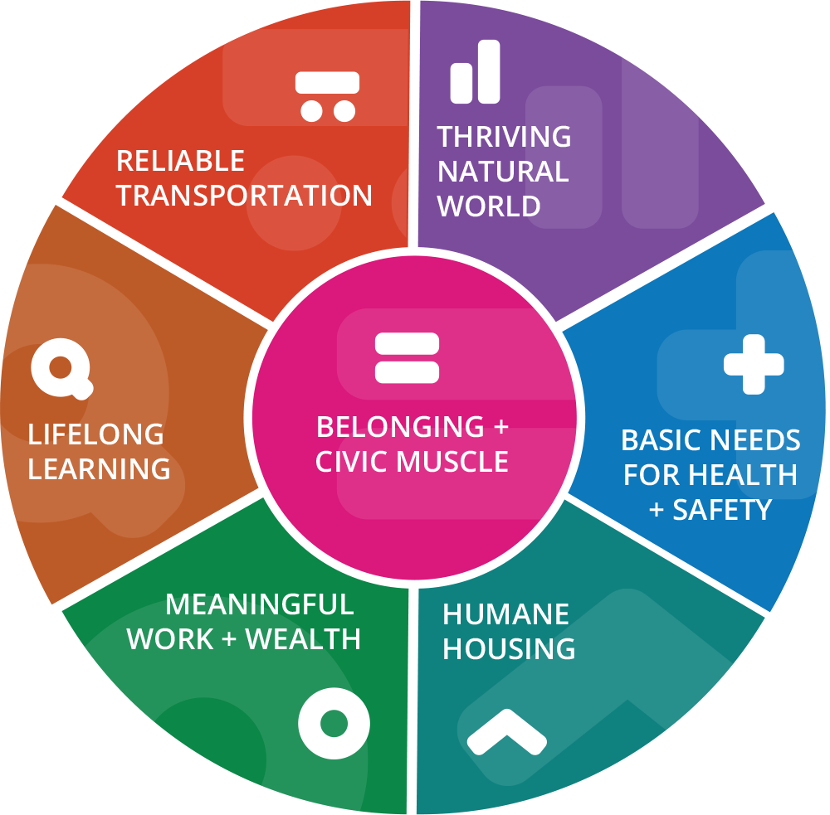
Vital Conditions for Well-being
80% of our health is influenced by factors outside of the healthcare system.
The Vital Conditions are what we all need, all the time, to thrive and be well.
HCD partners with and invests in communities to improve community vital conditions.

Slide 7
Goals / Focus Areas
Improve one or more of the Vital Conditions for Well-Being within low-to-moderate income (LMI) communities
Requests must focus on work within or across eligible LMI communities

Slide 8
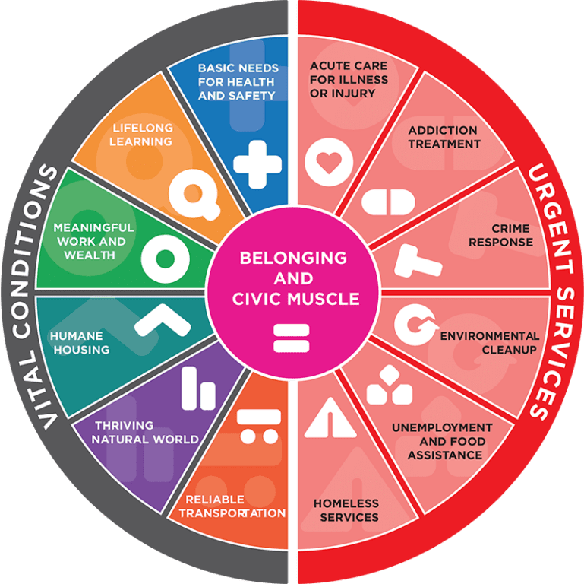
Vital Conditions vs. Urgent Needs

Slide 9
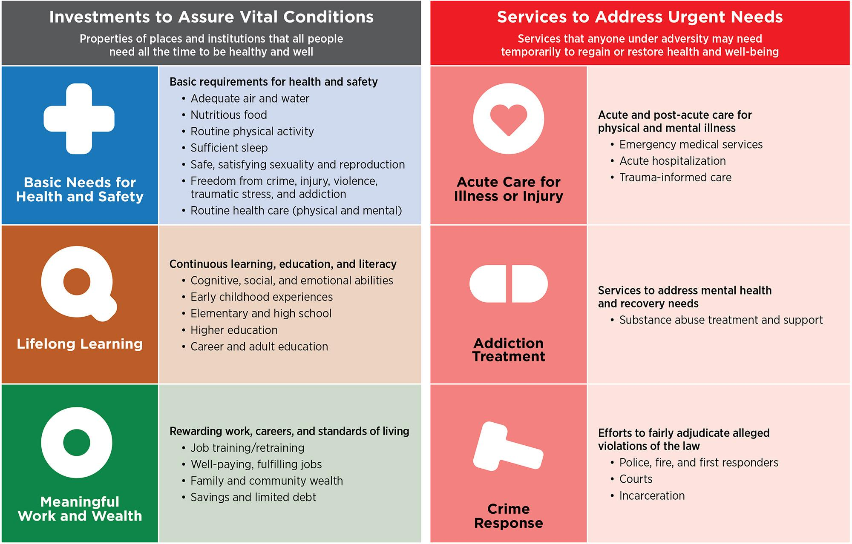
Vital Conditions vs. Urgent Needs

Slide 10
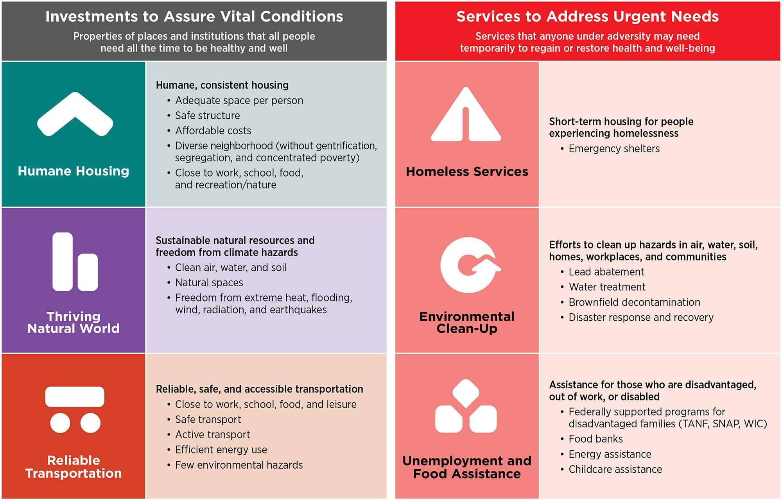
Vital Conditions vs. Urgent Needs

Slide 11
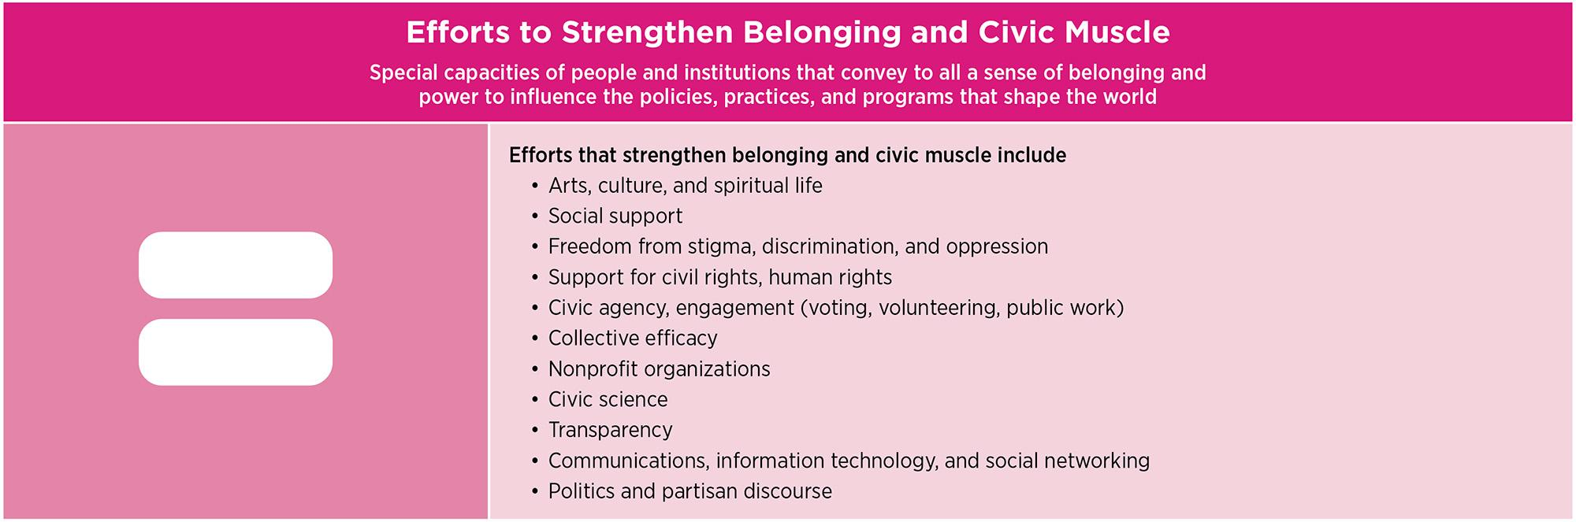
Vital Conditions vs. Urgent Needs

Slide 12
Available Funding & Timeline
Around $230,000 in total​
Grant proposals up to $25,000​
Typical awards will be between $10k and $25k​
Timeline​:
  Opens - August 1, 2026
  Closes – August 31, 2026
  Review period – September 2026
  Notice – Late September
  Grant period: October 1, 2026 - June 30, 2027 (9 months)

Slide 13
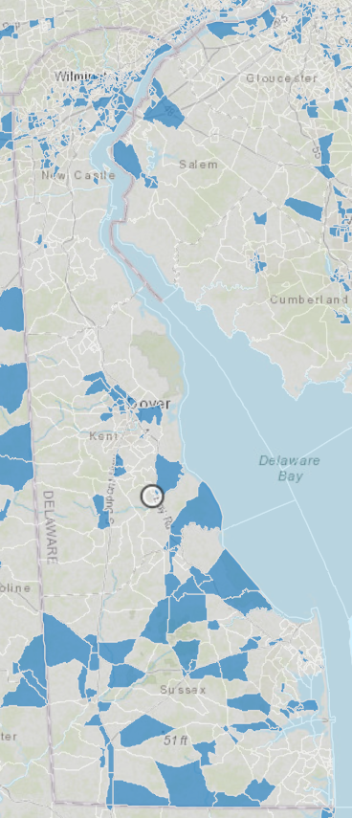
Eligibility​
Applying organization must be an incorporated not-for-profit 501c3 or have a fiscal agent
This opportunity is open to communities with 51% or more of residents classified as Low-to-Moderate Income (LMI), according to HUD's Low-to-Moderate Income Population data:
  HUD’s Low-to-Moderate Income Map
HUD’s Low-to-Moderate Income Map

Slide 14
Eligibility - Currently Funded HCD Partners​
May apply
No preference will be given
Cannot be used for a project already funded through HCD’s regular annual process
Must be for a separate project

Slide 15
Funding Exclusions
General operating expenses
Endowments
Religious organizations for sectarian purposes (However, projects that serve the entire community, regardless of religious affiliation, are eligible for support.)
Annual fundraising campaigns
Projects completed before the application deadline of this proposal
Individuals
Debt reduction
For-profit businesses
Purchase of office equipment, furniture or electronics
Direct lobbying
Any organization or project that is inconsistent with the HCD mission, vision, values, and strategy
Organizations or projects that unlawfully discriminate with regard to employees, volunteers, delivery of programs or services, or clients served based on age, sex, religion/creed, race, color, national or ethnic origin, sexual orientation, gender identity or expression, disability, marital status, military or veteran status, pregnancy or genetic information

Slide 16

The Process

Slide 17
The Process
Application Process:
Must be submitted using the online Delaware Community Foundation (DCF) portal.
Only one application per organization​
Other formats will not be accepted
Questions:
Questions on process or grant portal​
  Email Kelly Sheridan at KSheridan@delcf.org
Questions on content/strategy/fit​
  Email Kate Dupont Phillips at KDupontPhillips@delcf.org ​
  Schedule a 20-min discussion with Kate via Calendly.

Slide 18
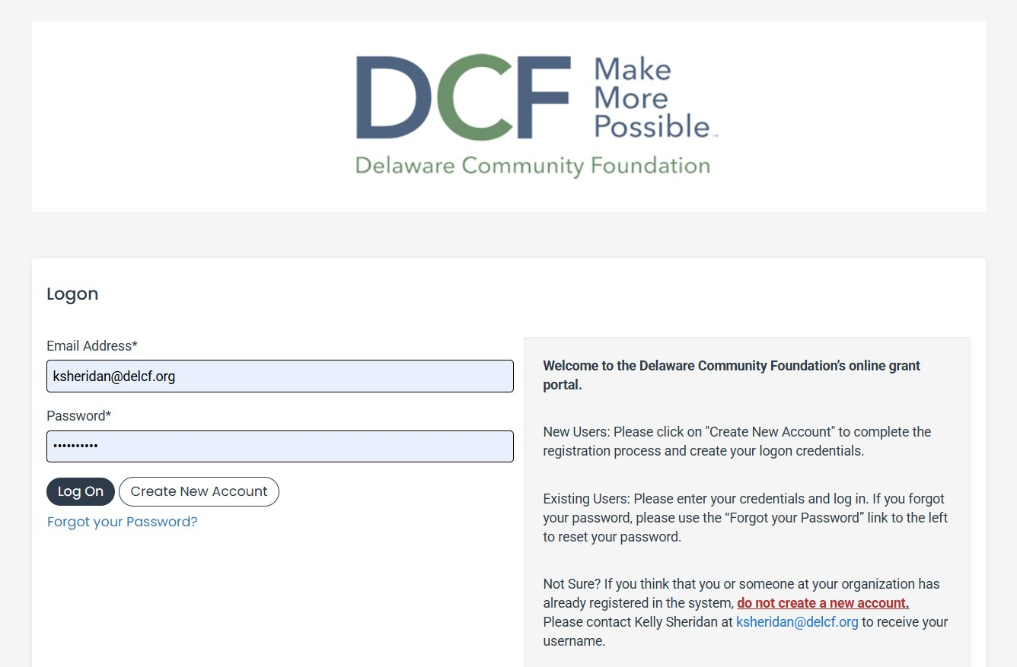
Applying Online

Slide 19
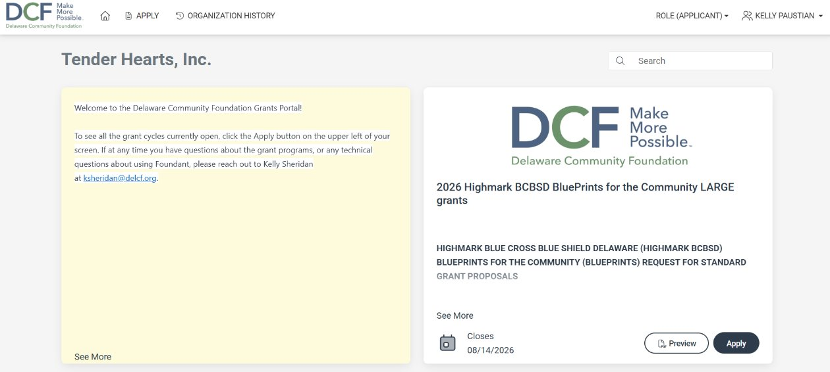
Applying Online

Slide 20
The Application
Organizational Information:
Organization Name
Organization Address
Contact Person’s Name
Contact Person’s Email
Contact Person’s Phone Number
Secondary Contact Person’s Name
Secondary Contact Person’s Email
Secondary Contact Person’s Phone Number
If applicable, fiscal sponsorship status

Slide 21
The Application
Proposal Details:
Eligible Census Tracts/ Census Block Group
Project Name
Project Description
Target Population
Project / Program Need
Address of physical project (if applicable)
Project Readiness and Organizational Capacity
Proposed Timeline
Measuring Success
Current Healthy Communities Delaware Funding (if applicable)
Additional Supporting Document 1 (Optional)
Notes:
Success: Explain what progress or success will look like and how it will be tracked and measured. What outputs will be produced as a result of this project?

Slide 22
The Application
Budget Information:
Total Request Amount
Organizational Budget
Project Budget
Payment Processing:
Authorization of Payment
Attach Bank Account Details (Voided Check or Letter from Bank)
Signature to Authorize Payment Processing
Acknowledgement:
Applicant Authorization
Signature of Executive Director/CEO or Authorized Personnel

Slide 23
The Rubric
Project Name
Eligibility
Vital Conditions
Logic
Rationale
Project Readiness and Organizational Capacity
Budget and Fiscal Stewardship

Slide 24
The Review Process
Applications are reviewed for completeness and fit.
Proposals are reviewed and scored by individually by members of a review committee.
The review committee meets as a group to recommend organizations for funding.
List of recommended awards are submitted to the DCF Boards for approval. ​
Once approved, applicants will be notified of grant decisions.​

Slide 25
Reporting
Final Report​: July 15, 2027
Did you hit a roadblock? Let us know!
  We aim to be flexible to accommodate timeline changes. Communication is key!​

Slide 26
Any Questions?
Thank you for joining!
Healthy Communities Delaware
Thriving People. Thriving Places.

