Slide 1

How to Get $10K/Month of Free Advertising
Google Grants for Nonprofits Workshop

Slide 2



























Our Clients
WE ARE FIRST ASCENT
DO SOMETHING GREAT AND TELL PEOPLE ABOUT IT.
Our Awards

Slide 3
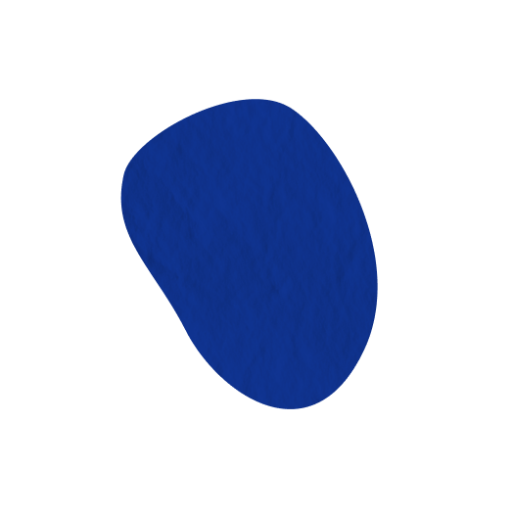


A Bit About Us
John Himics
Bruna Viana
President of First Ascent Design
Design and Marketing Specialist at First Ascent Design

Slide 4
What is Google for Nonprofits?

Slide 5

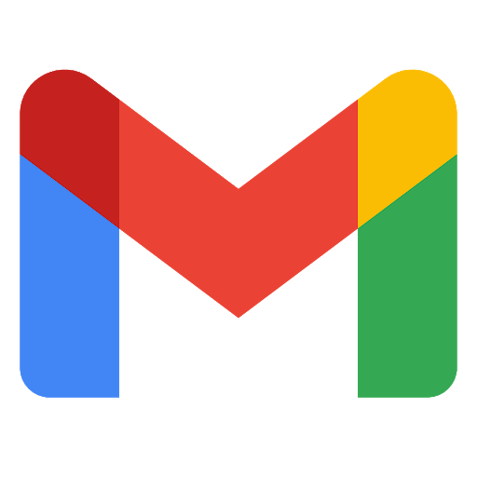
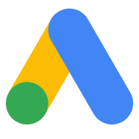


Available in over 65 countries
Gives nonprofits free access to:
Google Workspace
Google Ad Grants
YouTube Nonprofit program
Google Maps Platform

Slide 6
Available in over 65 countries
Gives nonprofits free access to:
Google Workspace
Google Ad Grants
Provides access to $10K/month of in-kind advertising search ads
YouTube Nonprofit program
Google Maps Platform

Slide 7

Program Requirements
Must be a:
501(c)(3) nonprofit charitable organization in good standing
or
a group exempt organization with proven affiliation to a central 501c3 nonprofit
Cannot be a:
governmental entity or organization
hospital or healthcare organization
school, academic institution, or university
💡 Google offers a separate program for schools:

Slide 8
Application Process

Slide 9

Application Process
Step 1: Confirm that you meet the eligibility requirements
We covered this a minute ago!

Slide 10
Application Process
Step 2: Request a Google for Nonprofits account at www.google.com/nonprofits
You Will Need:
A Google email account
Your organization’s EIN
Your organization’s physical address
Your organization’s contact information (email)
Your organization’s Mission Statement (500 characters max)

Slide 11
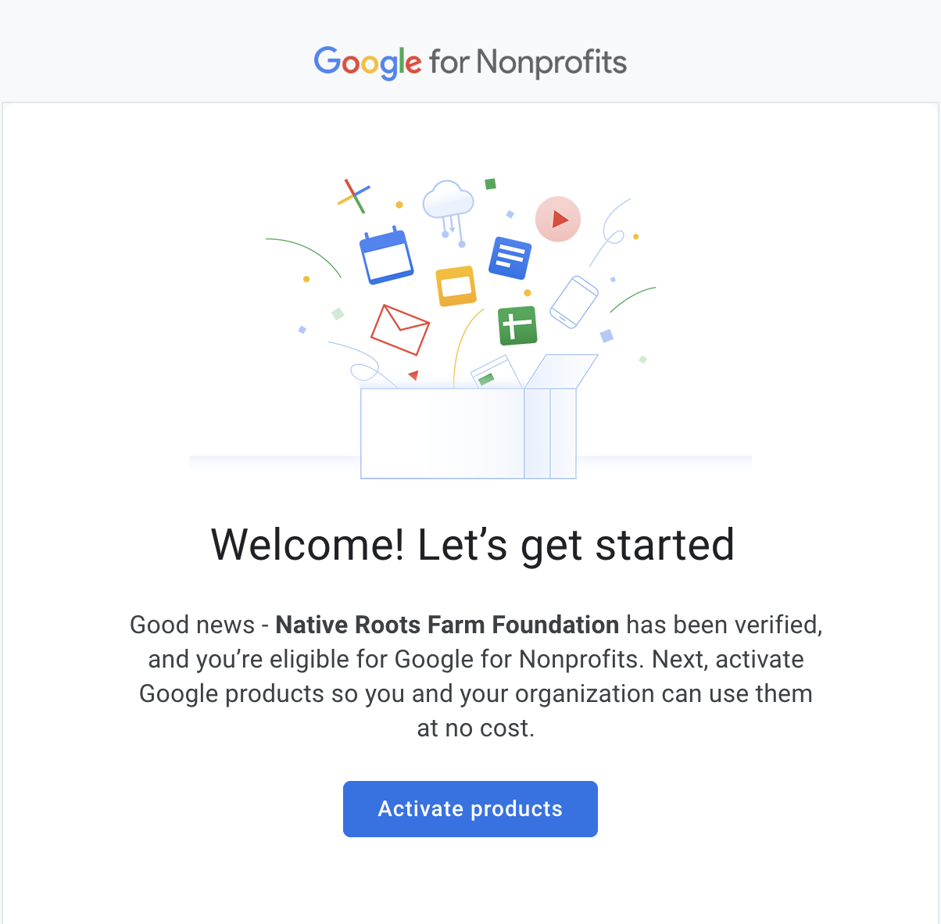

Application Process
Step 3: Wait for verification
This takes about 2-14 business days
You will receive an email when verified
Your Organization

Slide 12

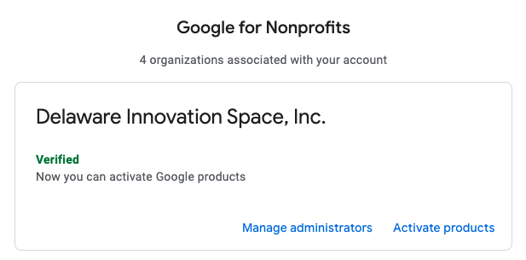
Application Process
Step 4: Activate and use the individual products
Your Organization
Google Ad Grants

Slide 13
What Are Search* Ads?
*AKA SERP (Search Engine Results Page) Ads, Text Ads, SEM (Search Engine Marketing) or PPC (Pay-Per-Click)

Slide 14
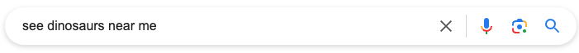
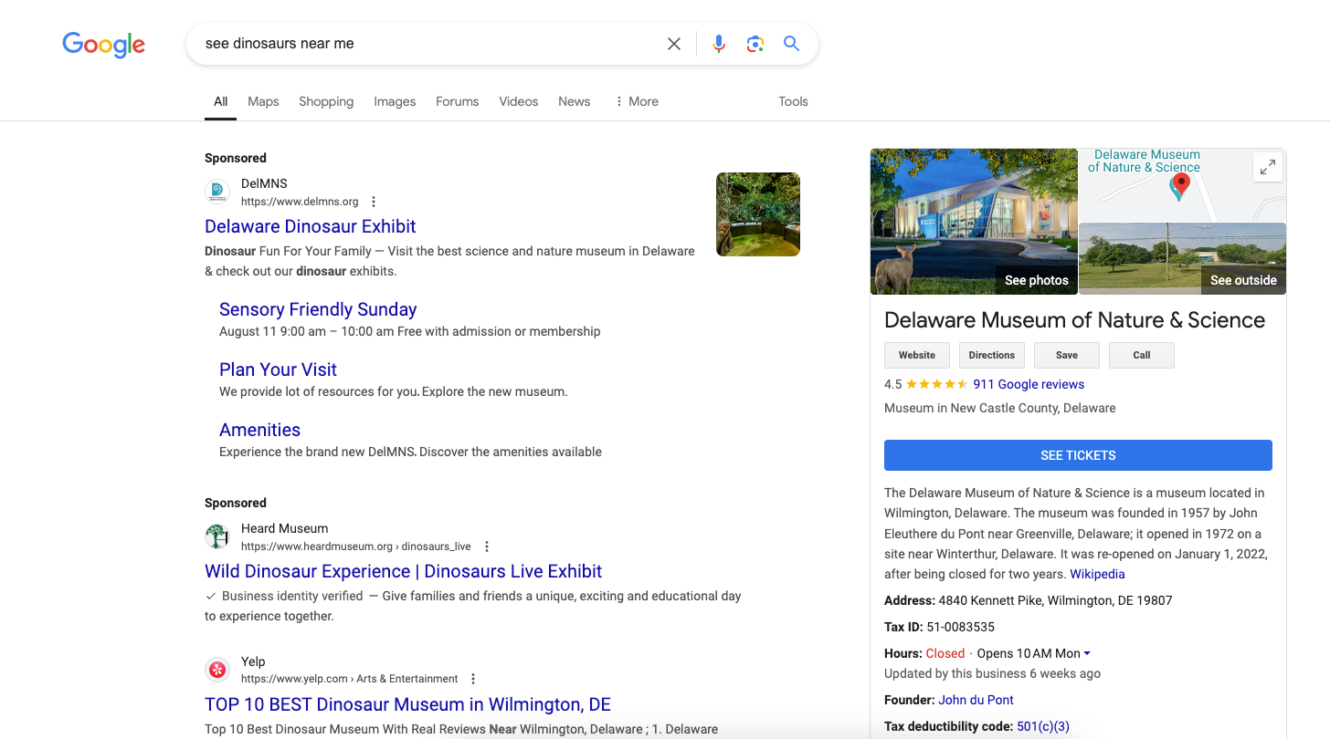
Search Ads
Demand capturing: ads show on the search results page based on what people are searching for

Slide 15
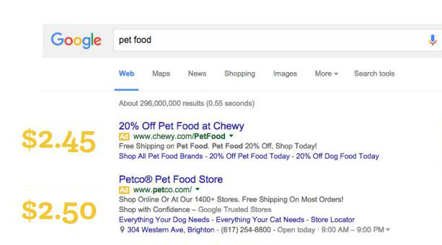
How Search Ads Work
~14 billion searches per day
Every search is an auction
Google Grants is a secondary auction
Protip: Quality Score

Slide 16
Search Ads - Key Components
Keywords
Ad copy (headlines & descriptions)
Assets/Extensions
Landing page
Audience targeting
Geographic targeting
Conversion tracking

Slide 17
Search Ads - Keywords
Search terms you want to appear for on the search engine results page
An advertiser selling running shoes could target keywords such as ‘running shoes’ or ‘sports gear’
An advertiser looking for volunteers could target keywords such as ‘volunteer opportunities near me’ or ‘ways to give back’

Slide 18
Search Ads - Keywords
What to consider when selecting keywords:
Search volume (average number of monthly searches)
Difficulty score (how hard it is to earn a top-10 organic search ranking)
Cost per click (how much you pay each time someone clicks on your ad)
Match type (how closely the keyword needs to match with the user’s search query)
Broad (ads may show on searches that are related)
“Phrase” (ads may show on searches that include the meaning)
[Exact] (ads may show on searches that are the same meaning)

Slide 19
Search Ads - Keywords
Tool recommendations:
Google Keyword Planner (free)
Ahrefs (paid)
SpyFu (paid)
Moz (free & paid options)
Answer the Public (free & paid options)
Google search (free)
Tips
Take advantage of negative keywords
If possible, look at what competitors are doing
Routinely check the search term reports for new ideas

Slide 20
Search Ads - Ad Copy
Headline (3 to 15) Up to 30 characters
Description (2 to 4) Up to 90 characters
Assets / Extensions
Sitelinks
Lead Form
Location
Call
& more!

Slide 21
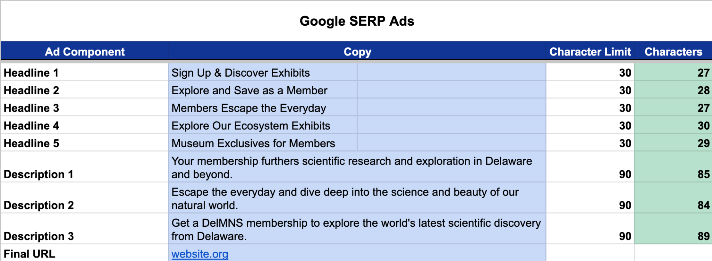
Search Ads - Ad Copy

Slide 22
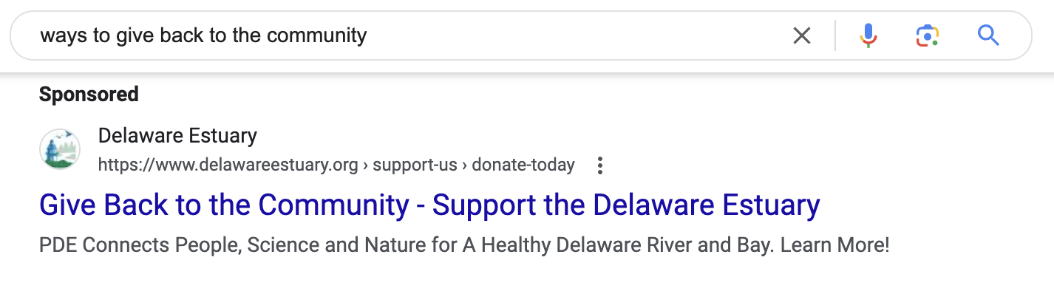
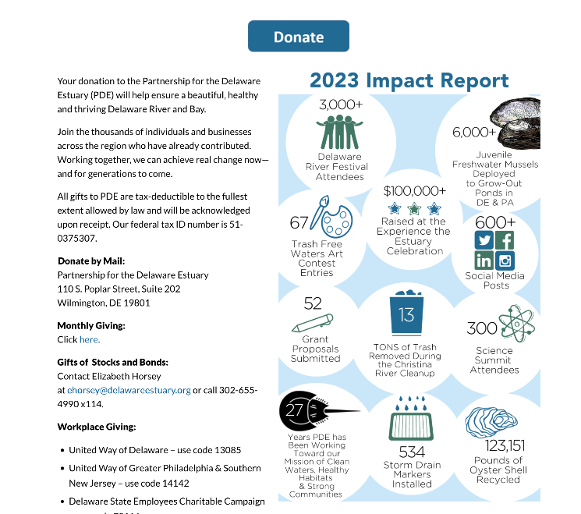
Search Ads - Ad Copy
Tips
Do keyword research first
Include keywords & calls-to-action in your headlines and descriptions
Make sure your ad reflects the content on your landing page (and vice-versa)

Slide 23
Search Ads - Other Pieces
Who are you talking to?
Geographic location (mandatory)
Age and gender
Interests
Household income
What actions do you want to drive?
Donations
Ticket sales
Email sign-ups
Calls
Engagement with content on your website
Where will people go?
Landing page

Slide 24
How to Structure Your Campaigns

Slide 25
Campaign Structure
Campaign
Keywords
Keywords
Ad Group 1
Ad Group 2
Ad 1
Ad 2
Ad 1
Ad 2

Slide 26
Let’s Take a Look Behind the Scenes

Slide 27
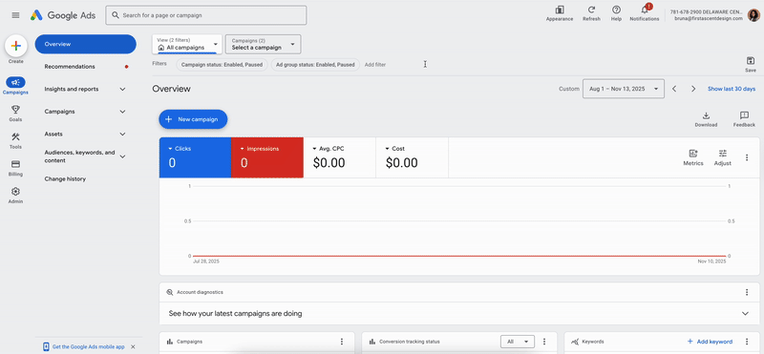

Slide 28
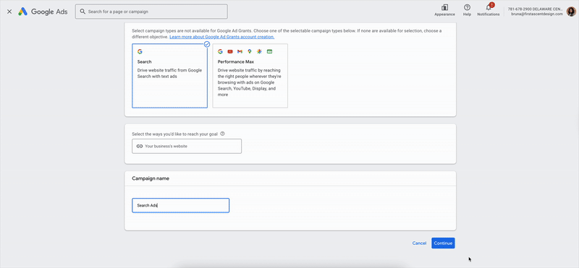

Slide 29
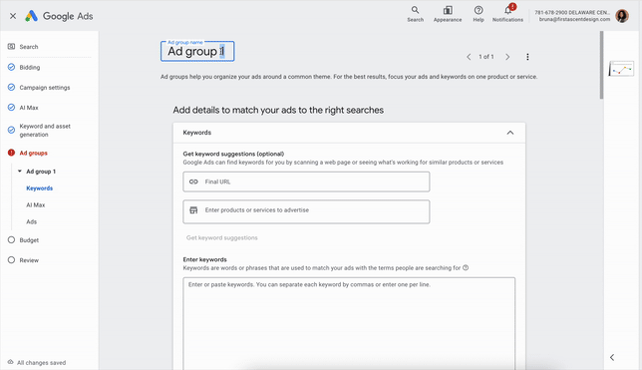

Slide 30
Requirements to Stay Compliant

Slide 31
Requirements to Stay Compliant
Ad Performance
Minimum of 5% click-through rate each month
At least 1 conversion per month
Account Structure
Proper location settings
At least 2 ad groups per campaign and 2 active, unique ads per ad group
At least 2 unique sitelinks
Other Limitations
No single-word keywords permitted
No overly generic keywords permitted (“free videos”, “e-books”)
No keywords with a quality score of 1 or 2 permitted

Slide 32
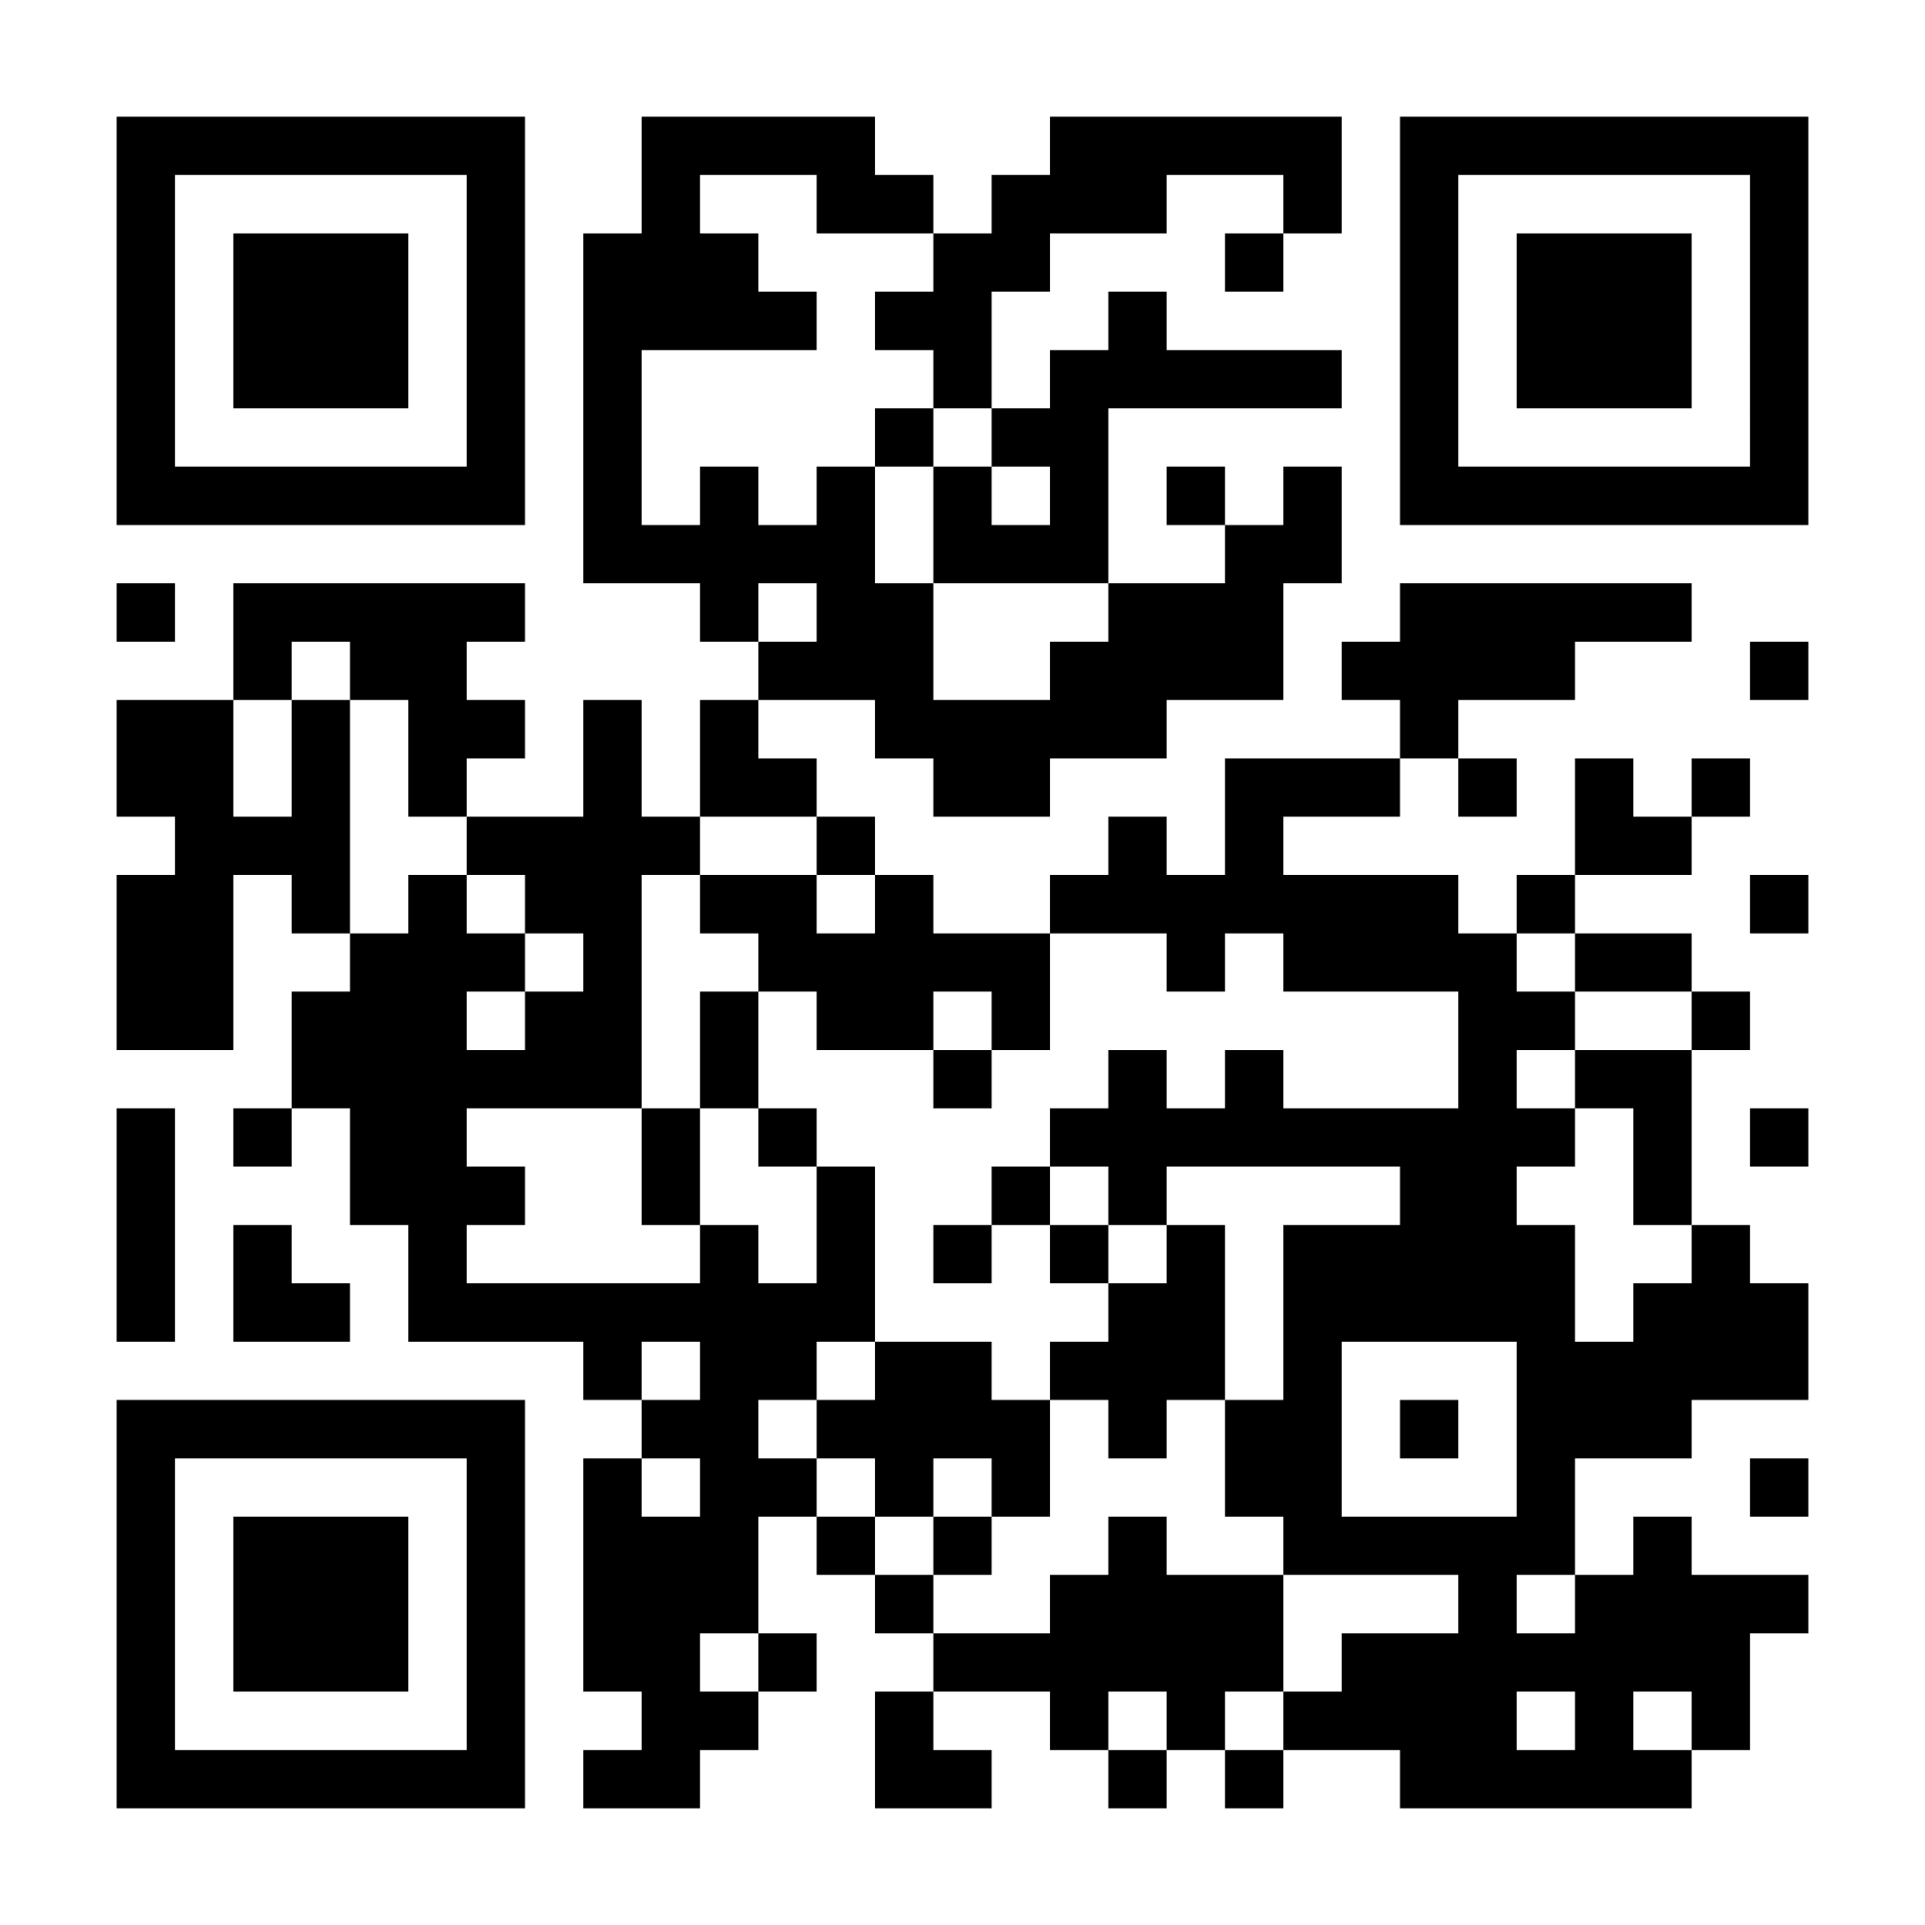
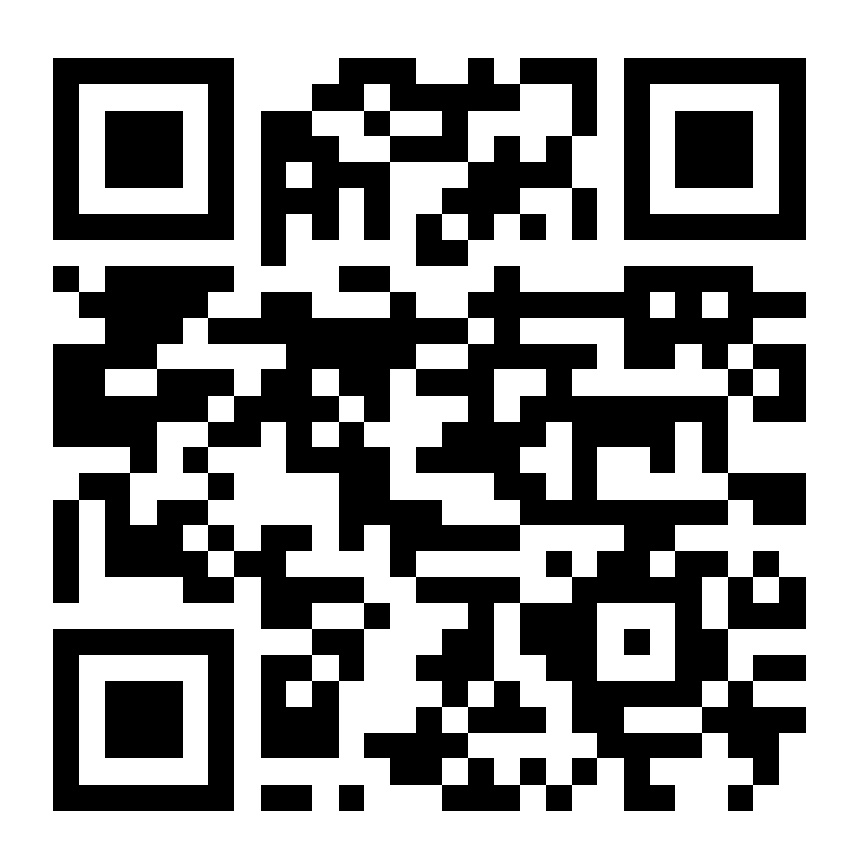



Questions?
@firstascentDE
linkedin.com/in/JohnHimics linkedin.com/in/bruna-gonçalves-viana
john@firstascentdesign.com bruna@firstascentdesign.com
Connect with John!
Connect with Bruna!
Thank you!

