Slide 1
GRANT REVIEWER WORKSHOP
2024 GRANT CYCLE

Slide 2
OVERVIEW

Slide 3
AGENDA
Welcome
Grant Committee Introductions and Responsibilities
2024 Timetable
2024 Grant Application Rubric
Tips/Focus
Foundant Overview
Q&A

Slide 4
GRANT COMMITTEE
INTRODUCTIONS
OVERVIEW/RESPONSIBILITIES
Three-year commitment
Review grant applications, score according to rubric and ultimately select final grantees.
Attend this training
Attend final selection meeting - March 7th* (Zoom meeting)
Attend the award ceremony, if possible (May 15th)

Slide 5
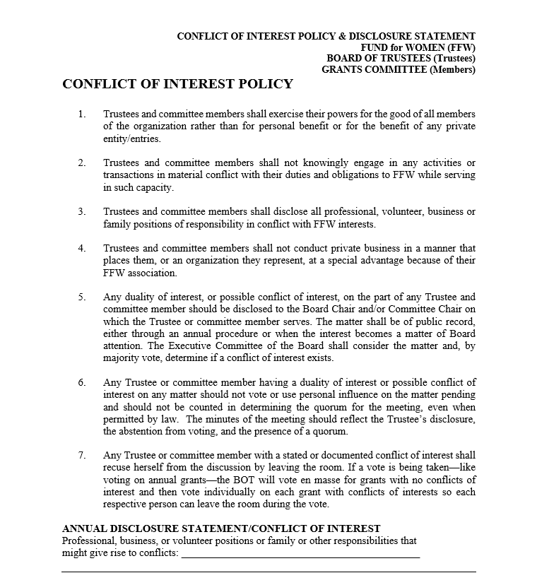
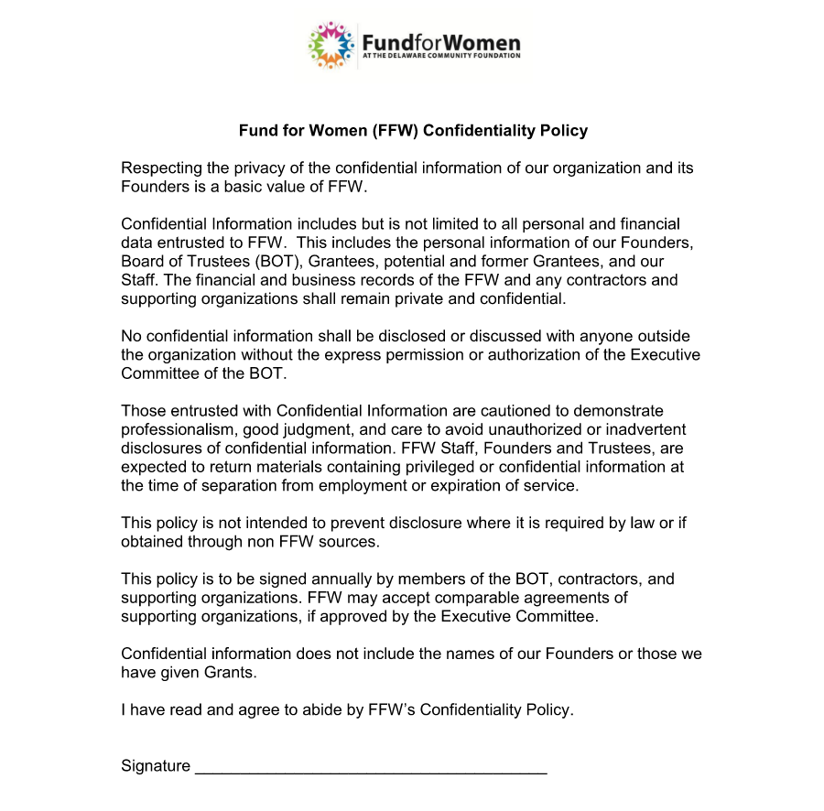
GRANT COMMITTEE
Notes:
Conflict of interest and confidentiality

Slide 6
2024 GRANT CYCLE
Jan. 1 – 31
Applications accepted online via Grant Portal
Feb. 6-16
First round of grant reviews
Thursday, March 7
Final review meeting-via Zoom
May 15
Grant Awards Ceremony, DelTech in Dover
April
Successful applicants submitted to the FFW and DCF Boards for approval. Approved applicants will be notified. All applicants will be able to request reviewer comments.
Jan. 16 & 24
Grant Reviewer Workshops
Feb 21-29
Second round of grants

Slide 7
GRANT APPLICATION CRITERIA AND GUIDELINES
Applications must:
Address the needs of Delaware women and/or girls
Provide proof of the Agency’s exempt status under section 501(c)3 of the Internal Revenue Code
Include a detailed description of the project budget, and the organization’s budget
Be received by Midnight on January 31, 2024.
All 2023 grant recipients, must be current on their grant evaluations before submitting an application for 2024
Notes:
We use Guidestar to confirm 501c3 status
The sooner you submit your application, the more time I have to review and get back to you if anything is missing or needs to be updated. If you wait until the 31st, there won’t be time for you to submit updates.

Slide 8
GRANT APPLICATIONS TO BE EXCLUDED
If any of the following apply:
Funding request is for an individual
Organization does not have 501(c)3 status
Funding request is for capital
Funding is for debt reduction
Project is for an endowment campaign
Request for funding exceeds $15,000
Agency received a prior FFW grant and failed to submit a timely final grant evaluation of the project
Notes:
Historically, the final report is due by September 30th of the year after the award - this gives 16 months after actually receiving the grant. This past cycle because of COVID, we are just finishing up the 2019 grant final reviews.

Slide 9
RATING CRITERIA
The Fund for Women focuses its grant-making on programs relating to:
Health, wellness and life skills that lead to future economic self-sufficiency for girls and women in Delaware
Many programs that could lead to future economic self-sufficiency, include:
Arts, sports, mentoring, education, food, financial literacy, clothing, jobs training, etc.
Remember our mission: “To empower women and girls to achieve their potential”
Notes:
We use Guidestar to confirm 501c3 status
The sooner you submit your application, the more time I have to review and get back to you if anything is missing or needs to be updated. If you wait until the 31st, there won’t be time for you to submit updates.

Slide 10
FINANCIALS
FINANCIAL STATEMENT
Statement of Revenue page of your 990 part VIII for 2021/22
Accounting records showing the board approved budget and actuals
CURRENT OPERATING BUDGET
PROJECT BUDGET
Clearly and specifically itemize the costs that will be covered by a Fund for Women Grant –
Notes:
This is a benefit when we use the synergies of other agencies to make the project successful.

Slide 11
ADDITIONAL QUESTIONS/PROCESS:
ATTACHMENTS
We have added a chance to attach a short video link talking about the importance of their program and why we should fund it. This is optional
Optional upload of any additional items, pictures, PowerPoint, ect.
Notes:
We use Guidestar to confirm 501c3 status
The sooner you submit your application, the more time I have to review and get back to you if anything is missing or needs to be updated. If you wait until the 31st, there won’t be time for you to submit updates.

Slide 12
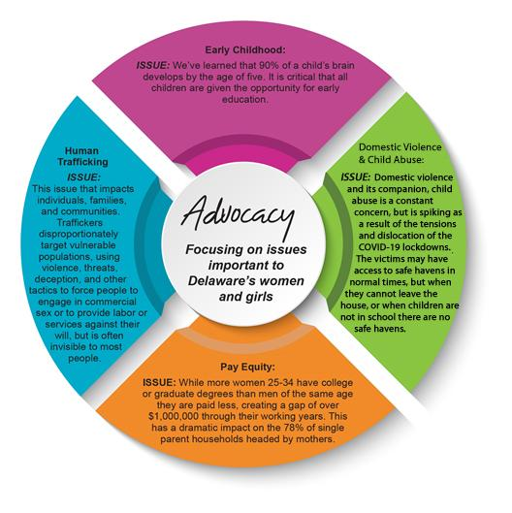
ADVOCACY CONNECTION:
FFW Advocacy Alignment: this will not impact scoring; we are using this to keep our advocacy group connected with the grant requests we are seeing
FFW Advocacy Focus Areas
Notes:
We use Guidestar to confirm 501c3 status
The sooner you submit your application, the more time I have to review and get back to you if anything is missing or needs to be updated. If you wait until the 31st, there won’t be time for you to submit updates.

Slide 13
DIVERSITY, EQUITY AND INCLUSION:
We have removed our attachment for demographic information about your program recipients
We have added an entire section towards the end of the application, asking for questions about your organization, and your efforts around DEI
This information will not impact your chances for an award, the reviewers will not see this information.
We are hoping that by asking this information, it will prompt your organization to begin these conversations and tracking if you have not already done so.
Notes:
We use Guidestar to confirm 501c3 status
The sooner you submit your application, the more time I have to review and get back to you if anything is missing or needs to be updated. If you wait until the 31st, there won’t be time for you to submit updates.

Slide 14
TIPS/FOCUS
Take the following attributes into consideration as you evaluate/score:
The maximum is $15,000
Overall value
Proposal is clear, organized and complete
Plan for recruiting participants in the project
Collaboration/Leveraging (with other entities)
Innovation/Creativity/Uniqueness
Number of people impacted
County/Counties served
Notes:
We use Guidestar to confirm 501c3 status
The sooner you submit your application, the more time I have to review and get back to you if anything is missing or needs to be updated. If you wait until the 31st, there won’t be time for you to submit updates.

Slide 15
TIPS/FOCUS
Take the following attributes into consideration as you evaluate/score:
Need and value of service offered
Clear goals and objectives
Clear description of project needs and the impact on the lives of recipients
Reasonable allocation of resources
Sound methodologies
Reasonable and well documented plan for staffing the project
Clear plan to measure results
Notes:
We use Guidestar to confirm 501c3 status
The sooner you submit your application, the more time I have to review and get back to you if anything is missing or needs to be updated. If you wait until the 31st, there won’t be time for you to submit updates.

Slide 16
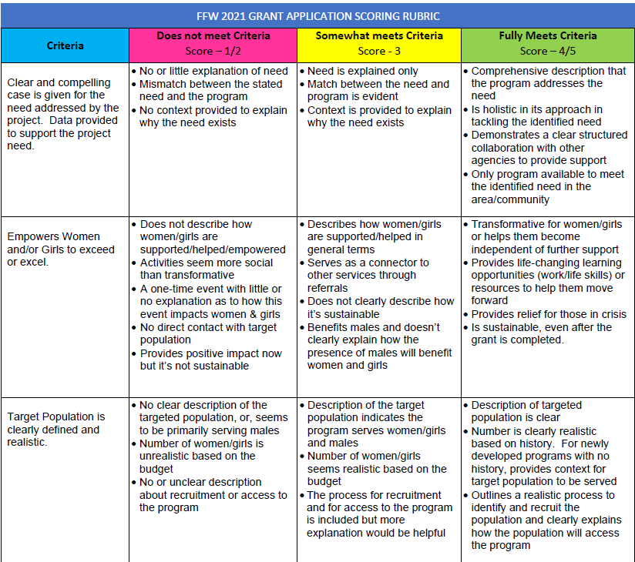
RUBRIC

Slide 17
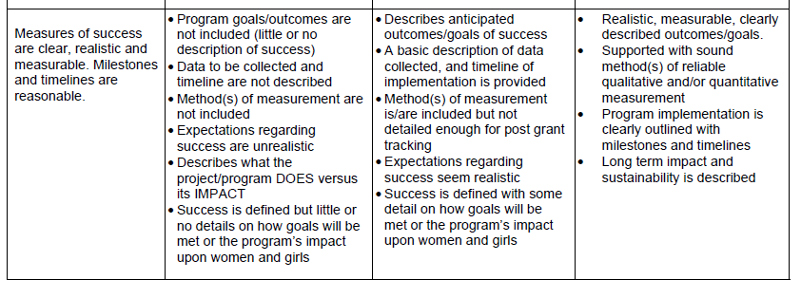
RUBRIC

Slide 18
REVIEWER ACTIONS, COMMENTS AND OBSERVATIONS
It’s important to include comments. Many unsuccessful applicants have reached out to me for their comments so that they can improve their request for this year.
Timely completion of the review
Bell shaped curve scoring (not every application can be a 10)
Notes:
Historically, the final report is due by September 30th of the year after the award - this gives 16 months after actually receiving the grant. This past cycle because of COVID, we are just finishing up the 2019 grant final reviews.

Slide 19
EXAMPLE COMMENTS
Comments They have finally figured out what to write to get money from us. Good for them! This seems to be a well targeted program, backed up with statistics and facts and should help empower girls with anti bullying and STEM. Agency are the greatest at creating the next generation of leaders in our community. This is a large 501(c)(3) organization. The program described has potential for short-term positive impact for about 50 high-needs girls. The program describes an ambitious rationale for improving girls' outlook and personal skills. Long-term impact is not well-specified. It is unclear how program will ensure attendance of girls coping with multiple risk factors and other challenges (e.g., transportation, family responsibilities). This reviewer has implemented programs in partnership with the agency in another region and has great respect for the organization. Regarding assessment, pre- and immediate post-surveys are acceptable, but the plan would be stronger if it included longer term follow-up following participation, to ascertain long-term effects of the program. This application would have been stronger with more details as noted. Would recommend for funding on the strength of the organization's reputation for quality programming. Had concerns with the premise that the participants "identified as needing GS to improve behavior". This seems to be a flawed premise for enrollment. | Comments they have established programs that fulfill a need and target a population in need of intervention. Federal funds have dried up and we can help replenish and keep this excellent program going. "Not sure how they plan to provide 4 workshops per week. How many sessions are held at each location? How often would an individual participant actually attend a session. The budget page made no sense" I wonder whether they have thought through partnerships - given it seems there would be overlap with what other Sussex programs are already doing. Seems this is more of a concept than a program well thought out. This appears to be a request for funding to be used for general operations and not specifically targeted to a program. The organization is a 501(c)(3). This application is very vague and unclear. It does not specify, in any detail, a girl-focused program to be supported by FFW funding. It seems clear that boys are also served by the organization and would be included in significant numbers in programming to be supported by FFW funding. If boys are included, this reviewer would like more information about numbers and how programming for boys' benefits girls and women within some larger context. It appears that the FFW grant would support a single position, but it's not clear whether other funding would be necessary to support this position. Too many questions, cannot recommend for funding. | Comments "Wow! Delaware had the highest rate of unplanned pregnancies in the United States with 57% unplanned in 2016. “ Reviewer's sense is that this may be a good program, but it was difficult to tell from the proposal what exactly the program is.

Slide 20
RECUSAL
Do not rate the application if:
You are on its Board
Employed by the organization
Have a current contract (or are in negotiations for a new contract) with the organization
Currently receive direct services from the organization
Please review all grants as soon as you can and contact Kim Ilardi if you have any conflicts of interest and you need to recuse yourself
Notes:
We use Guidestar to confirm 501c3 status
The sooner you submit your application, the more time I have to review and get back to you if anything is missing or needs to be updated. If you wait until the 31st, there won’t be time for you to submit updates.

Slide 21
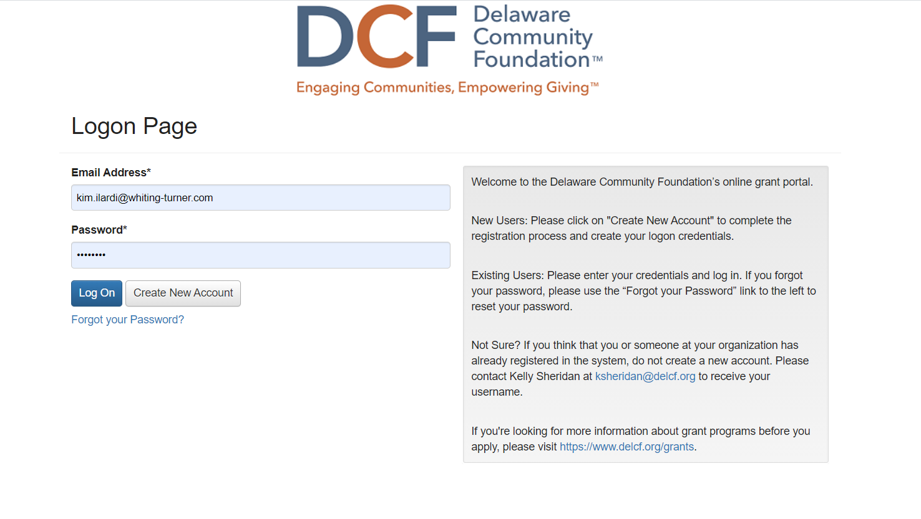
FOUNDANT OVERVIEW
Create an account - Foundant
Notes:
Enter your email
Click on “Forgot Password” and follow the instructions
Recommend you create a new password

Slide 22
FOUNDANT OVERVIEW
Assigned Grants
Notes:
Click on “Your Evaluations”
Click on the “!”

Slide 23
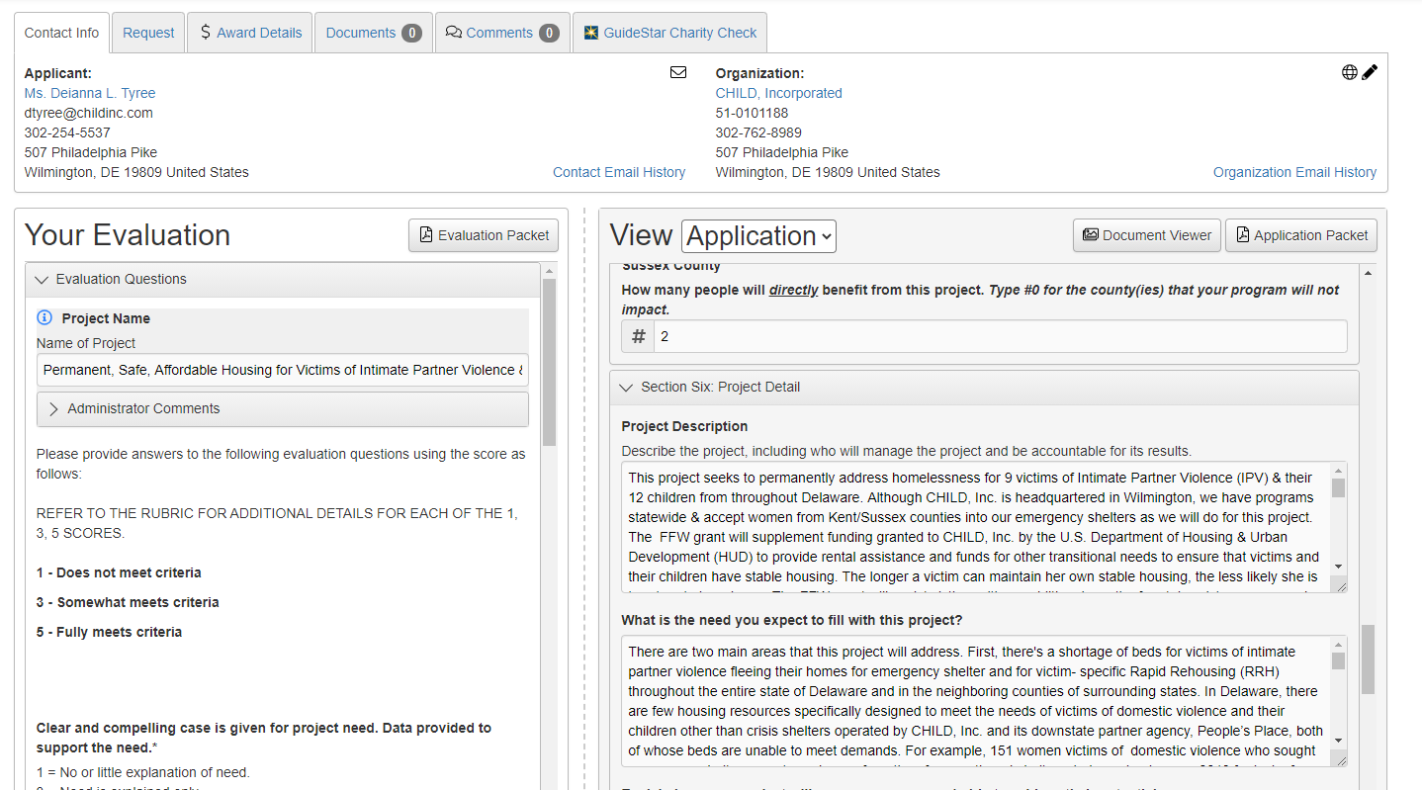
FOUNDANT OVERVIEW
Notes:
Click on “DOCUMENT VIEWER” to see the budget.
Score each of the key attributes and provide comments (on left of screen).
Save once completed

Slide 24
QUESTIONS
?
?
Questions
Katie Johnson, Grants Chair
Grants@defundforwomen.com
302.563.6830
Notes:
Thank you for serving!!!

